Slide 1
Assignment
Presented by S.Vinish

Slide 2
Agenda
📘SAP & its evolution
📘 SAP R/3 architecture
📘 Support packages
📘 SPAM / SAINT
📘 SNOTE
📘 KERNEL
📘 Logical system
📘 Client
📘 Transport Management
📘 System Transport Request

Slide 3
SAP and Its Evolution

Slide 4
SAP (Systems, Applications, and Products in Data Processing) is a German multinational software company founded in 1972.
It provides enterprise resource planning (ERP) software that integrates various business processes.
Evolution:
R/1: Centralized architecture (1972)
SAP R/2: Mainframe-based 2-tier architecture (1979)
SAP R/3: Client-server 3-tier architecture, became widely popular (1992)
SAP ECC (ERP Central Component): Enhanced R/3 version, part of SAP Business Suite.
SAP S/4HANA: Launched in 2015, built on SAP HANA (in-memory database), real-time analytics, simplified data model.

Slide 5
SAP BASIS Roles & Responsibilities

Slide 6








SAP BASIS (Business Application Software Integrated Solution) acts as the system administrator for SAP environments.
Installation and configuration of SAP systems
Database management and tuning
Managing background jobs
Transport management
User administration and authorization management
System monitoring & performance tuning
Applying patches and upgrades
Troubleshooting and system recovery

Slide 7
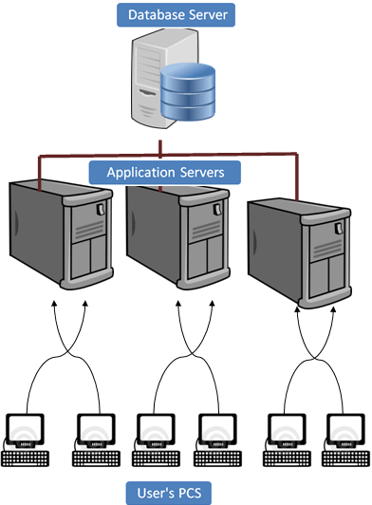
SAP R/3 Architecture
R/3 stands for Real-time, 3-tier architecture.
Presentation Layer: SAP GUI or web browser.
Application Layer: SAP kernel, work processes, manages business logic.
Database Layer: Stores all SAP data (master, transactional).
Each layer is independent and can run on separate servers.

Slide 8
🧱 Three Layers of SAP R/3 Architecture
1️⃣ Presentation Layer:
📌What it is: The user interface of the SAP system.
📌Used by: End users (via SAP GUI or web browser).
📌Function: Sends user input to the application layer and displays the output.
📌Example: SAP GUI screen where users enter data or view reports.
2️⃣ Application Layer
📌What it is: The processing center of the SAP system.
📌Used for: Executing business logic, programs, and managing communication.
📌Components:
Dispatcher
Work Processes (Dialog, Background, Update, etc.)
Message Server
📌Function: Processes user requests, runs ABAP programs, manages load balancing.
3️⃣ Database Layer
📌What it is: The data storage layer.
📌Used for: Storing all SAP system data – both transactional and master data.
📌Function: Handles all read/write operations.
📌Common Databases: Oracle, MS SQL, SAP HANA, DB2

Slide 9
User’s PC:- Users can access SAP system in two ways:-
👉Through SAP GUI
👉Through Web browser
It’s called front-end. Only the front-end is installed in the user’s PC not the application/database servers.
Front-end takes the user’s requests to database server and application servers.
Application Servers: – Application server is built to process business-logic. This workload is distributed among multiple application servers. With multiple application servers, the user can get the output more quickly.
Application server exists at a remote a location as compared to the location of the user PC.
Database Server: –Database server stores and retrieves data as per SQL queries generated by ABAP and Java applications.
Database and Application may exist on the same or different physical location.

Slide 10
Support Packages
SPs are the collections of corrections, updates, and improvements provided by SAP for its software components.
These are mainly bug fixes, legal changes, and minor enhancements that help keep your SAP system stable, secure, and up-to-date.
They are similar to software "patches" or "updates" in traditional IT systems.
📦What’s Inside a Support Package?
A Support Package may contain:
ABAP program corrections
Dictionary changes (tables, views)
Reports and transactions
UI updates
Security fixes
Performance optimizations
Country-specific legal changes

Slide 11
🔄 How Are Support Packages Applied?
Support Packages are applied using the following tools:
SPAM (Support Package Manager) for ABAP-based systems
SAINT (SAP Add-On Installation Tool) for Add-ons and plugins
📥 Steps to Apply SPs Using SPAM:
Download SPs from SAP Support Portal (as .SAR files)
Upload and extract them using SAPCAR
Go to T-Code SPAM
Load and queue the package
Apply – SPAM will check dependencies and apply the changes
Monitor the process (each phase is logged)
Perform post-processing if needed

Slide 12
SPAM (Support Package Manager)
➤ Purpose:
Used to apply support packages and SAP updates (ABAP-based systems only).
➤ Key Points:
SPAM = "SAP Patch Manager"
Handles:
Support packages
Language imports
Add-ons (if simple)
Can check the queue, dependencies, and apply patches step by step
Helps manage versions and avoids system inconsistencies
➤ T-Code: SPAM

Slide 13
SAINT (SAP Add-On Installation Tool)
➤ Purpose:
Used to install and upgrade SAP Add-ons or Business Functions.
➤ Key Points:
SAINT = "SAP Add-On Installation Tool"
Handles:
Add-on components (e.g., industry-specific solutions)
Business functions
Some support package stacks (with multiple components)
Allows bundle installation of multiple add-ons
Can be used to uninstall some add-ons (if supported)
➤ T-Code: SAINT

Slide 14
SNOTE (SAP Note Assistant)
➤ Purpose:
Used to apply SAP Notes (code or config corrections provided by SAP).
➤ Key Points:
SAP provides Notes to fix bugs or enhance functions
SNOTE tool helps download and implement these Notes
Handles:
Manual or automatic correction instructions
Prerequisite checks
Requires internet connection (or manual Note upload)
Common for applying pre-requisite corrections before big updates.
➤ T-Code: SNOTE

Slide 15
Kernel
✅ Definition:
SAP kernel is the core runtime engine for SAP systems.
It is a set of executables and libraries (compiled binaries) that sit on the OS level and run the SAP system.
✅ Role:
Acts as an interface between SAP applications (ABAP/Java) and the operating system/hardware.
It includes core processes like:
disp+work – dispatcher and work process handler
sapstartsrv – start/stop and monitoring
igswd – Internet Graphics Server daemon
R3trans – transport tool
tp – transport tool controller

Slide 16
Logical System
A Logical System is a unique name for an individual SAP client.
It identifies systems during communication and data transfers (ALE, IDoc, RFC).
Essential for cross-system processes like client copies, system migrations, and data distribution.
T-Code: BD54
Step-by-Step Process in BD54:
Enter T-Code: BD54
Click "New Entries"
(or choose an existing entry to modify if needed)
Enter:
Logical System Name (example:NW5CLNT---)
Description (example: Creating Dev System Client 100)
Save (Ctrl + S)
Transport (Optional):
If required across systems (like Dev → QA → Prod), include the Logical System in a transport request.

Slide 17
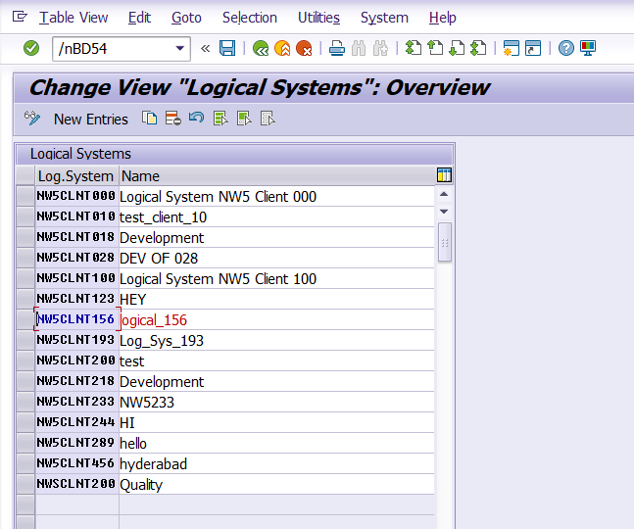
After Entering T-Code: BD54

Slide 18
Client
A Client in SAP is a self-contained unit within an SAP system that holds its own data, users, and configurations — like a separate business entity or environment.
🔑 Key points:
Identified by a 3-digit number (ex., 000, 100, 800)
All clients share the same SAP system and database, but data is logically separated
Common usage:
000 – SAP standard (master) client
001 – copy of 000, used for customizing
066 – SAP EarlyWatch
Custom – used for development, test, training, production (ex., 100 for dev, 300 for prod)

Slide 19
Client Creation
🔧 Pre-Requisites
You need SAP_ALL or similar administrative authorizations.
You must log in to the SAP system with a user in client 000 or an existing client where you have administrative access.
✅ Steps to Create a New Client in SAP
Step 1: Go to Transaction Code SCC4
T-Code: SCC4
This is the Client Administration screen.
Click the “New Entries” button to create a new client.

Slide 20
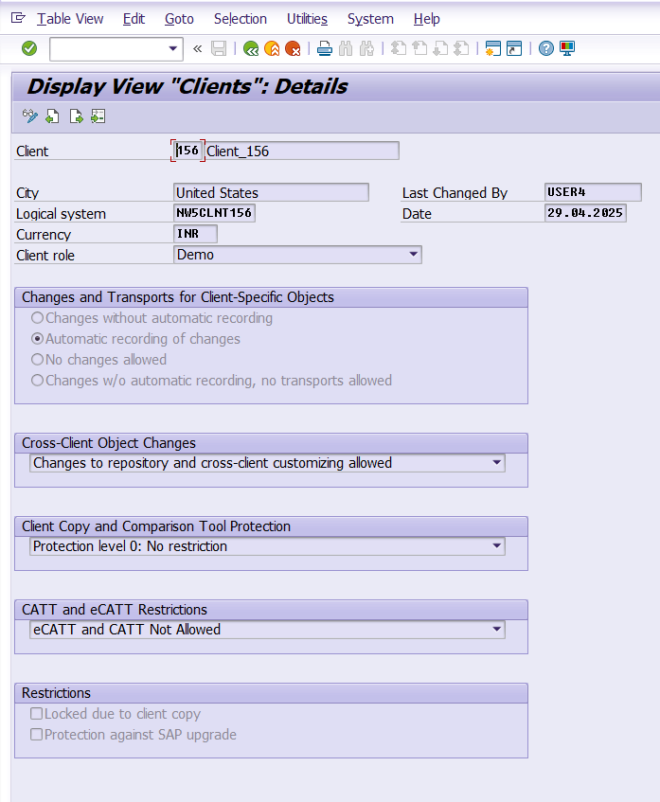
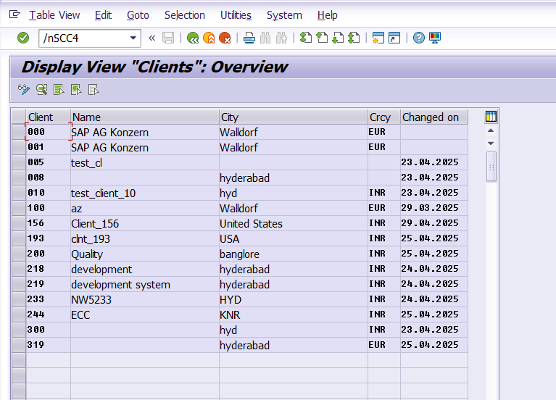
After entering into T-Code: SCC4

Slide 21
Client Copy
A Client Copy is the process of copying all or selected data from one client to another within the same system or between different systems.
There are different methods depending on what you want to copy: configuration, master data, transactional data, or all.

Slide 22
Client Copy Types & Methods
1️⃣ Local Client Copy
Within the same SAP system
T-Code: SCCL
Copies from one client to another inside the same system
Requires client export to be configured and source data available.
Common profiles:
SAP_ALL: Full copy (customizing + master + transaction data)
SAP_CUST: Only customizing data
SAP_USER: Only user master records & authorizations

Slide 23
2️⃣ Remote Client Copy
Between two different SAP systems
T-Code: SCC9
Requires:
RFC connection between source and target systems
Source client must be accessible
Uses same profiles (SAP_ALL, etc.)
3️⃣ Client Export/Import (2-Step Copy)
Export from one system → Import into another
Export: T-Code SCC8 (creates export files in /usr/sap/trans)
Import: T-Code SCC7/STMS (Transport Management System)
Used when systems are not connected via RFC
Ideal for copying large or secure clients

Slide 24
🚦 Pre-Steps Before Client Copy
Create the target client using T-Code SCC4.
Log in to the target client with *user SAP **.
Unlock source and target clients for copy.
Make sure enough free space is available.
Stop background jobs (if needed).
Backup system (recommended before large copies).
✅ Post-Steps After Copy
Check logs: SCC3
Check user authorizations.
Activate batch jobs.
Regenerate buffers (optional).
Adjust RFCs, logical systems, ALE settings if needed.

Slide 25
Thank you

